Slide 1





RESTAURANT CHATBOT USING LSTM
Presented By:
Syed Jaleel S
syedjaleel850@gmail.com
Reg no: 422521104037
University College Of Engineering,Villlupuram

Slide 2
OUTLINE
PROBLEM STATEMENT
PROPOSED SYSTEM/SOLUTION
SYSTEM APPROACH
ALGORITHM & DEPLOYMENT
RESULT
CONCLUSION

Slide 3
Problem Statement :
2019
The project aims to develop a Restaurant Reservation Bot utilizing Long Short-Term Memory (LSTM) networks to automate the booking process. The bot will be designed to understand natural language inputs from users, such as reservation requests, party size, preferred date and time, and special requirements. Through LSTM's memory retention capabilities, the bot will maintain context throughout the conversation and generate coherent responses.

Slide 4
Proposed System/Solution :
Chatbot Architecture Design:
2019
• Design a chatbot architecture utilizing LSTM (Long Short-Term Memory) networks for sequence modeling and natural language understanding.
LSTM Model:
• Implement LSTM layers to capture sequential dependencies in user queries and responses.
• Experiment with variations in the number of LSTM layers, hidden units, and dropout rates to optimize model performance.
• Incorporate word embeddings to represent words in a continuous vector space and enhance the model's ability to understand semantic relationships.

Slide 5
Proposed System/Solution :
Training and Optimization:
2019
Train the LSTM model using backpropagation through time (BPTT) and optimization algorithms like Adam or RMSprop.
Fine-tune hyperparameters such as learning rates and batch sizes to optimize performance.
Evaluation and Testing:
Evaluate the chatbot's performance using metrics such as accuracy, response time, and user satisfaction.
Conduct extensive testing with diverse datasets and user scenarios to assess robustness.

Slide 6
SYSTEM APPROACH
System Requirements:
2019
1.Hardware:
CPU: A multi-core CPU is adequate for processing user requests and running the LSTM model efficiently.
Memory (RAM): A minimum of 8GB of RAM is recommended for handling user interactions and maintaining context. Additional RAM may be beneficial for larger conversational datasets and more complex models.
Internet Connection: An internet connection is necessary for accessing external APIs, retrieving real-time reservation information, and providing updates to users.

Slide 7
SYSTEM APPROACH
2.Software:
Python: The project is implemented using the Python programming language for its versatility and extensive libraries.
TensorFlow/Keras: TensorFlow, along with its high-level API Keras, is utilized for building, training, and deploying LSTM models due to its robustness and ease of use in deep learning tasks.
Natural Language Processing (NLP) Libraries: Libraries such as NLTK (Natural Language Toolkit) or spaCy are used for processing and understanding user input in natural language.
Flask/Django: Web frameworks like Flask or Django are employed for creating the bot's backend infrastructure, providing HTTP endpoints for communication and handling reservation requests.
Google Colab: These platforms can be used for interactive development, experimentation, and documentation.

Slide 8
ALGORITHM & DEPLOYMENT
1.LSTM Model Development:
Developed the core functionality of Restaurant Bot using a Long Short-Term Memory (LSTM) deep learning model.
LSTM enables the bot to understand and generate responses based on the context of user queries, enhancing the conversational experience.
2019
2.Training the LSTM Model:
Trained the LSTM model on a dataset comprising past booking interactions and customer preferences
Utilized techniques such as sequence modeling and backpropagation to optimize the model for accurate predictions.
3.Hyperparameter Tuning:
Conducted extensive experiments to fine-tune hyperparameters such as learning rates, sequence lengths, and network architectures.
Selected the optimal hyperparameters to improve the performance and efficiency of the LSTM model.

Slide 9
ALGORITHM & DEPLOYMENT
4.Deployment:
The trained GAN model and associated code are deployed into a GitHub repository.
Included instructions for setting up the environment and running the code.
Created documentation and README files explaining the project, algorithm, and deployment instructions.
2019
5.Performance Evaluation:
User Interaction Analysis: Evaluate the chatbot's performance by analyzing interactions between users and the bot.
Sentiment Analysis:Use sentiment analysis to gauge user satisfaction based on the sentiment expressed during conversations.
Accuracy Assessment:* Measure the accuracy of the chatbot's responses by comparing them to expected outcomes.
Error Analysis: Conduct an error analysis to identify common mistakes made by the chatbot and areas for improvement.

Slide 10
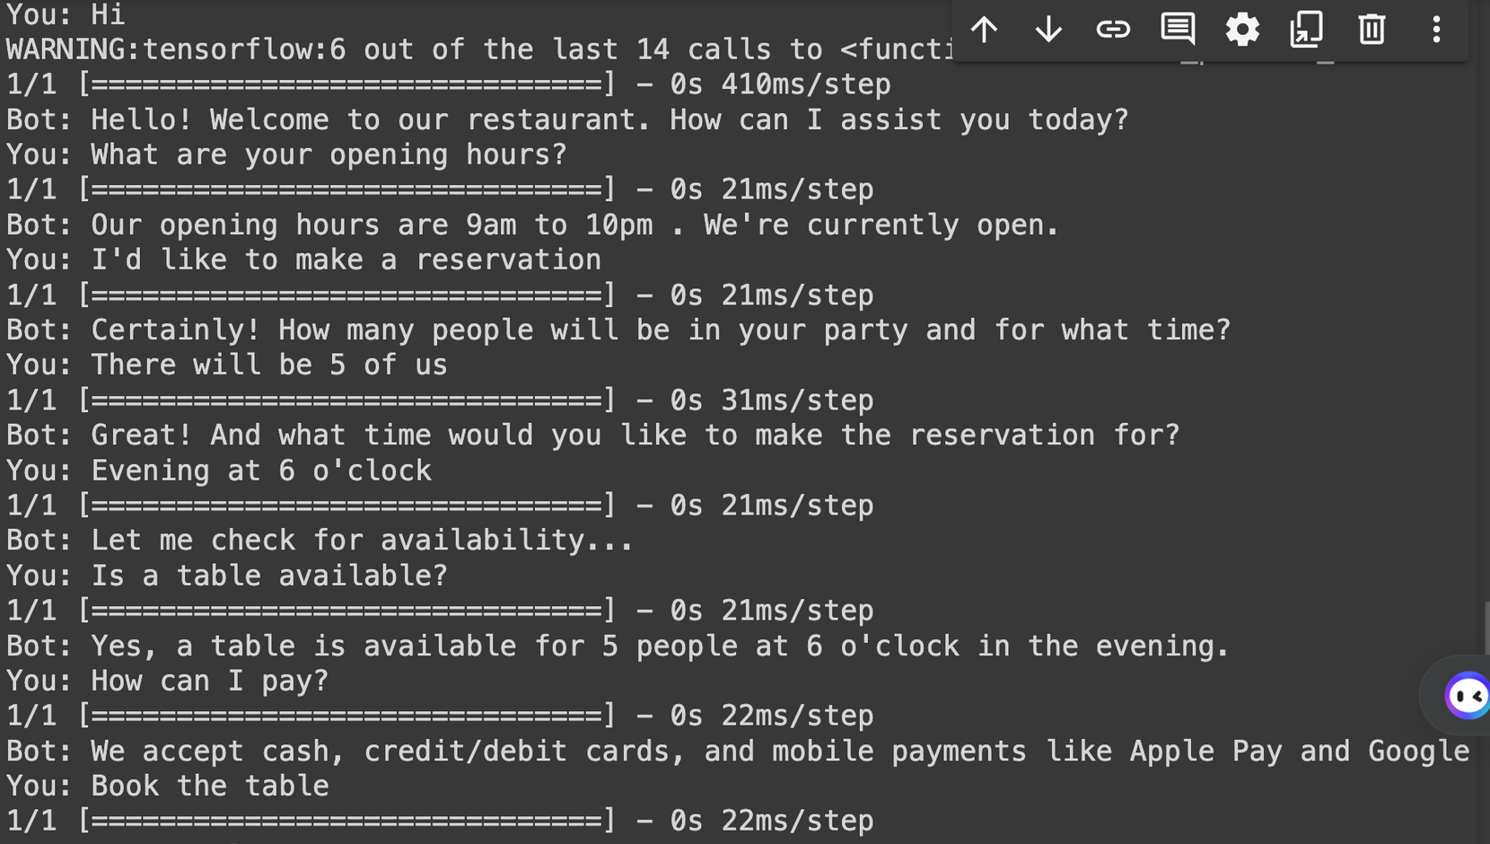
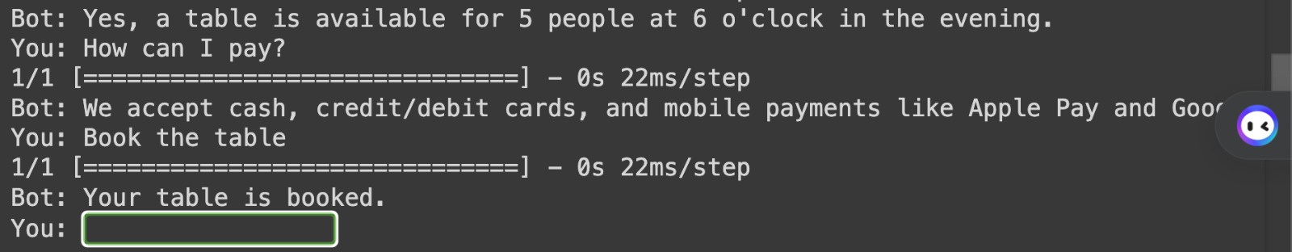
RESULT:
FRANCOIS MERCER
MANAGER

Slide 11
CONCLUSION :
In conclusion, our restaurant chatbot, powered by LSTM deep learning technology, represents a significant advancement in customer service and operational efficiency within the dining industry. Through its ability to understand user queries, provide personalized recommendations, and seamlessly handle reservations, the chatbot streamlines the booking process and enhances the overall dining experience for customers.

Slide 12
REFERENCES :
https://docs.python.org/3/library/json.html
https://numpy.org/
https://www.tensorflow.org/ https://keras.io/
https://www.tensorflow.org/api_docs/python/tf/keras/preprocessing/text/Tokenizer
https://www.tensorflow.org/api_docs/python/tf/keras/utils/pad_sequences

